Slide 1
Helping students invest in post-secondary education
Jeannette Smith, Ph.D. Candidate
Truckee Meadows Community College
coNVerge Conference, Fall 2016

Slide 2

Invest Defined by Dictionary.com
To put money to use
To use money
To use, give or devote, as for a purpose or to achieve something
To furnish with power or authority
To endow with a characteristic or quality
How would you connect these definitions to paying for college?

Slide 3
Only 3 Goals in this session
5 Common Myths busted through case study
Aid our students may not take advantage of
A game of Catch Phrase!

Slide 4
Anna is a senior at her high school and was not sure if she would be able to go to college. Overwhelmed with school and the marching band, she put off doing her FAFSA. In April, Anna was contacted by a band director at a college who saw her at a competition and is interested in offering her a scholarship. Anna must complete the FAFSA and submit a copy of her SARs report in order to apply.
What would you advise Anna to do?

Slide 5
Myth #1- It’s too late to do my FAFSA
Federal
Grants
Work Study
School
Grants
Scholarships
State
Grants
Scholarships
Loans
Work Study
Oct 1 is the new date
FAFSA is a 16-18 month cycle

Slide 6
Brandon is in the career center doing his FAFSA. He is on section 2, deciding which schools to enter. Brandon is interested in several schools but wants to know if he should list them in a particular order.
What do you tell him?

Slide 7
Myth #2- Schools look at a student's FAFSA and make decisions based on where they rank in the student's list of schools.
This is illegal.
To allay fears, as of 16-17, the U.S. Department of Education no longer shares your list of colleges with the schools receiving your FAFSA data.
Where did this come from? One thought is the data…
  “Statistically, students who are admitted to the college they list first on the FAFSA enroll there about half to two-thirds of the time. For the college listed second, about a third of students will enroll if they’re admitted. For the college listed third, about 10 percent will enroll if admitted.” (Kantrowitz, 2015)
Students can list 0-10 schools.

Slide 8
Caroline and her parents are in your office. You are going over everything she needs to do her senior year of high school. You have talked about re-taking the SAT and ACT tests. Her parents have asked questions about pictures and renting a cap and gown. Caroline meets all the requirements for the Millennium scholarship so far. As you are wrapping up your meeting, you ask if Caroline has completed the FAFSA. Her parents say they don't want to fill it out because they make too much money. What do you say?

Slide 9
Myth #3- My family makes too much money to qualify for FAFSA
Change the narrative, FAFSA is aid, Not all aid is FAFSA
Non-Need Aid Available, like the TEACH Grant
If you are interested in how EFC is calculated…

Slide 10
Danny has already graduated high school and is excited to share with you he received the Millennium scholarship. He does not feel the need to do his FAFSA because he thinks it's too late to apply and Millennium covers his tuition. Danny feels since his tuition is covered, college is paid for and he is good to go.
What information should you share with Danny?

Slide 11
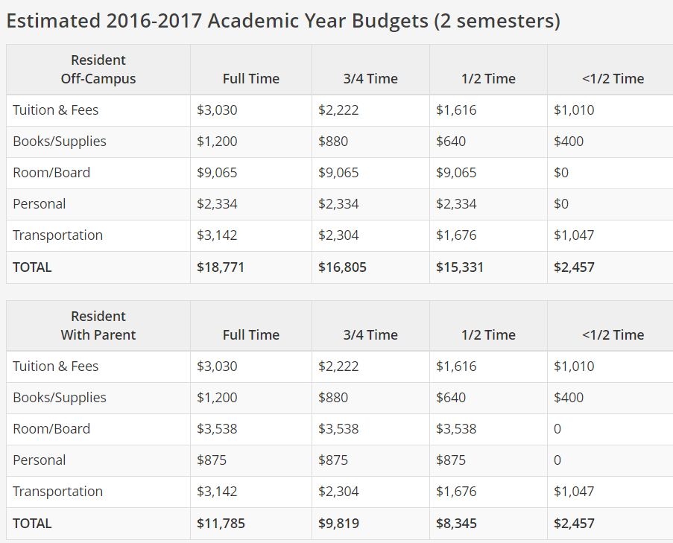
Myth #4- Millennium covers all costs of college
Any school that offers aid is required to publicly share their cost of attendance.
If it is an expensive program, request a budget review or increase
Not receiving Federal aid? Apply for all the scholarships you want! Otherwise, watch your budget.

Slide 12
Eleanor was enrolled in 12 credits at the beginning of the Fall semester. In September, Eleanor had a family emergency and dropped her classes. Eleanor did not inform anyone, she simply stopped attending class. You and Eleanor were having lunch when she shared this with you. She asks for your opinion on if she should enroll in Spring. What do you tell Eleanor? What resources can you share with Eleanor to help her make a decision?

Slide 13
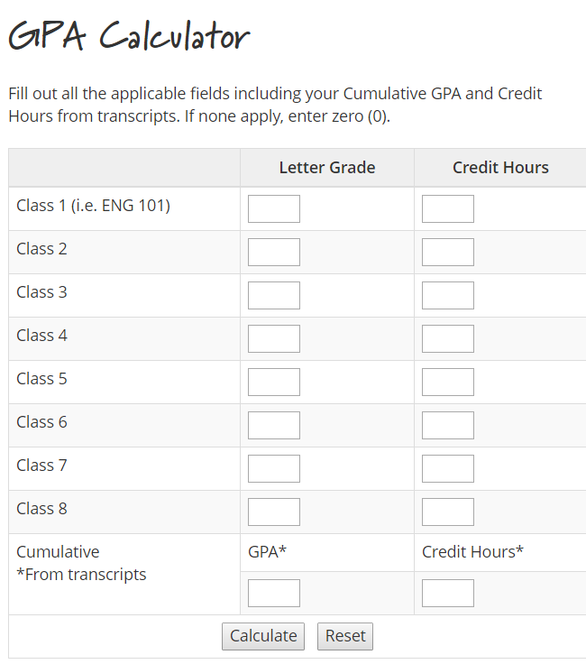
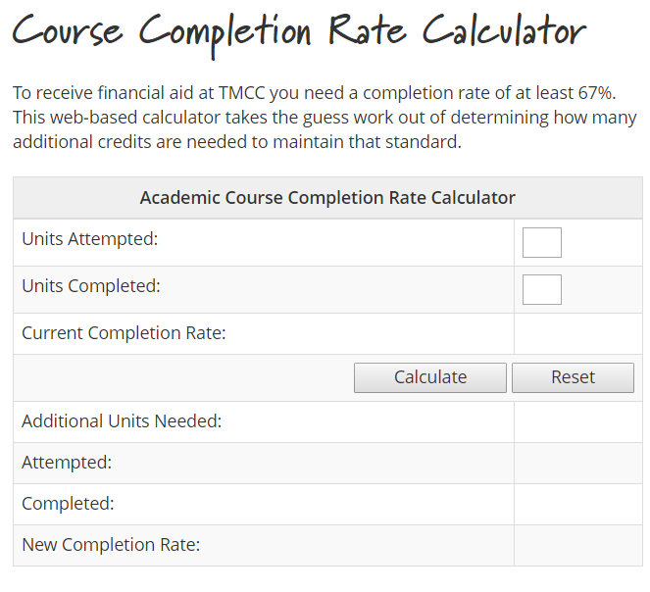
Myth #5- Dropping a class does not affect my financial aid.
Student must take action of some sort.
Pell Students- might have to pay money back
Withdrawing or Auditing still impacts SAP
  Satisfactory Academic Progress
  2.0 and 67% Completion Rate
The power of appeals

Slide 14
Aid our students may not take advantage of…
Silver State Opportunity Grant- up to $5,500
The Silver State Opportunity Grant Program (SSOG Program) is a state-supported financial aid program created by the 2015 Legislature pursuant to Senate Bill 227 (Chapter 387, Statutes of Nevada 2015). The 2015 Legislature appropriated funds to support the program under Senate Bill 514 (Chapter 534, Statutes of Nevada 2015). The sum of $2.5 million for Fiscal Year 2015-16 and $2.5 million for Fiscal Year 2016-17 were appropriated to NSHE for the purpose of the SSOG Program.
NSC, CSN, GBC, WNC, TMCC
EFC 8500 or less, Pell is 0-5234 this year
15 credits
To be considered "college-ready" for the purpose of SSOG Program eligibility, a student must be
  1) currently or previously enrolled in a 100 or above level mathematics and English course,
  2) placed into a college-level course under institutional placement policies for placement into at least Math120 and English 101, or
  3) previously successfully completed remedial coursework (evident by a C or better in Math 096 and/or English 098).
DACA are eligible!
(NSHE, 2016)

Slide 15
Aid our students may not take advantage of…
The Gilman Scholarship- up to $8,000
“The Benjamin A. Gilman International Scholarship Program offers grants for U.S. citizen undergraduate students of limited financial means to pursue academic studies or credit-bearing, career-oriented internships abroad. Such international exchange is intended to better prepare U.S. students to assume significant roles in an increasingly global economy and interdependent world.”
The Benjamin A. Gilman International Scholarship Program is funded through the International Academic Opportunity Act of 2000 and is sponsored by the Bureau of Educational and Cultural Affairs at the U.S. Department of State.
(Benjamin A. Gilman International Scholarship Program, 2017)
Online Application Process, several dates annually
Must complete the FAFSA
UNR Contact- Derreck Calkins at USAC dcalkins@unr.edu

Slide 16
Aid our students may not take advantage of…
Lucille Adin Women of Substance Scholarship- Reno Sparks NBPWC
Pat Cox Memorial Scholarship
Summer Bridge Programs
Community Foundation of Western Nevada
My Undocumented Life
Contact your financial aid office if you are not Pell eligible, but did your FAFSA!
  Institutional Grants
  Non-Need Aid
  Work Study

Slide 17
Catch Phrase!
You can do this in your office with staff and/or students.
Challenges you to be more mindful of how you communicate.
For today, this is financial aid focused!

Slide 18
Keep it Simple
Work Study- Some jobs on campus don’t have internal ways to pay you, but if you have work study, they can tap into Federal funds to pay you.
Income- How much money you or your parents made in a year.
Verification- A random audit of info. Turn in some paperwork and wait 2-4 weeks.
Enrollment vs Apply- You might APPLY to lots of schools, but you are not a student until you ENROLL in classes at a school.
Satisfactory Academic Progress- A rule to make sure you are going to class and passing your classes with a C average or better.
PELL grant- One type of aid you can get by completing the FAFSA. This is money that has been set aside to help you go to college and you don’t need to pay it back.
Estimated Family Contribution- A number that is created/calculated based on all of the information you put into the FAFSA. Depending on what this number is, you may qualify for different types of financial aid.

Slide 19
Let’s ReCap…
Goal #1- Mythbusting!
Goal #2- Encourage students to invest time researching and applying for different kinds of financial aid.
Goal #3- Change the narrative and terminology we use to make it simple to understand and encouraging, not overwhelming.

Slide 20
You Can Always Contact the Financial Aid Office!
Call, Email, Text, Stop in, Videos, Tweet, Facebook, Text, SnapChat, Apps

Slide 21
Questions?
jsmith@tmcc.edu
775-762-2482

